Slide 1
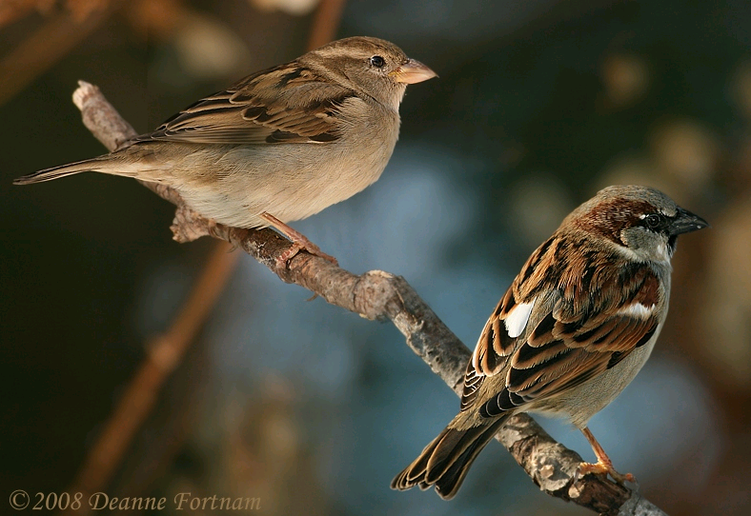
Specificity of Chemical Irritant Tolerance in Birds
Kayla L. Davis, Wayne L. Silver, and David J. Anderson Department of Biology, Wake Forest University, Winston-Salem NC USA
Introduction
Capsaicin (CAP), a derivative of the Capsicum pepper, is an irritant that stimulates the Transient Receptor Potential V1 (TRP-V1) channel of the trigeminal system. CAP is aversive to mammals, but available data suggest that CAP elicits no aversive behaviors in birds, even at concentrations higher than those avoided by mammals (Norman et al., 1992). Evolutionarily, this is significant because the Capsicum pepper may have evolved to selectively discourage consumption by mammalian seed predators without discouraging consumption by seed-dispersing birds (Tewksbury and Nabhan, 2001).
The objective of the present study was to explore the breadth of bird tolerance to chemical irritants in order to better understand how birds developed a tolerance of CAP. To answer this question, we used allyl isothiocyanate (AITC), a derivative of horseradish and an irritant that stimulates TRP-A1 channels, to determine if avian trigeminal tolerance is confined to TRP-V1, or if the tolerance is more broad, including other channels. Methyl anthranilate (MA), an avian irritant, was used as a positive control for aversive response behaviors (Kirifides et al., 2004). Phenethyl alcohol (PEA), which has no affect on birds (Mason and Silver, 1983), served as a control for neophobia to ensure that any aversive response observed was an actual representation of aversion, rather than distaste for any chemically enhanced food. These compounds were used in an ongoing study in house sparrows (Passer domesticus) to assess the general sensitivity of the bird trigeminal system to noxious chemical stimuli.
Conclusions
Our data suggest that birds can detect CAP and possibly AITC. The marginally significant results of head shaking events toward CAP and food rejection events toward AITC indicate that birds can differentiate these stimulants from un-enhanced food.
The nearly significant results for food rejection events toward AITC could indicate some slight aversion to AITC, although this conclusion is unlikely since consumption of AITC was not reduced relative to control. No significant differences existed between AITC and control for bill wiping and head shaking events, supporting the view that birds tolerate some compounds that irritate mammals, consistent with the frequently expressed position that the avian trigeminal system differs from that of mammals. The lack of significance in AITC bill wiping and head shaking results suggests that AITC is not aversive to birds. Further testing, with AITC and other chemical compounds, stimulating different TRP channels, can determine the extent of avian chemical irritant tolerance.
House sparrows consumed less CAP than control food, and shook their heads more (marginally significant) after eating CAP than after eating control food, as they did also after eating the positive control, MA. These results show that birds can differentiate between these stimulants and un-enhanced food. Insignificant results for the effect of PEA on bird behavior and food consumption indicate that neophobia was not the cause of observed aversive behaviors. Since neophobia was not a factor in test birds’ behavioral responses, we assumed that any significant aversive behaviors observed were the result of actual aversion to noxious chemical stimuli.
We conclude that CAP may be aversive to house sparrows, and that TRP-V1 tolerance of CAP may not be extended to all bird species. This would suggest that CAP intolerance is a new trait, developed relatively recently in evolutionary history. Continued study of different trigeminal stimulants in various bird species will further clarify the questions of avian trigeminal system tolerance to mammalian irritants and help to decipher the evolutionary links in the avian-mammal-pepper relationship.
Figure 1: Mean food consumption (grams) of eight birds for test groups, CAP vs. control, AITC vs. control, and seven birds for MA vs. control, and PEA vs. control. No significant difference existed in the amount of AITC and PEA eaten versus control (AITC: one-tailed p=0.153, PEA: one-tailed p=0.093). Significant differences were detected in the amount of CAP and MA eaten versus control (CAP: one-tailed p=0.045, MA: one- tailed p=0.047). Error bars in all figures indicate 95% confidence intervals.
Starved flies
Figure 2: Mean head shakes per minute for CAP vs. control (one-tailed p=0.063), AITC vs. control (one-tailed p=0.344), MA vs. control (one-tailed p=0.031), and PEA vs. control (one-tailed p=0.191).
Materials & Methods
Ten house sparrows were trapped and housed in individual flight cages. Birds were fed Purina Bird Flight Conditioner mixed in vegetable oil (0.075mL oil/ 1g chow=control). Before the test period, birds were food deprived, overnight, for twelve hours. Each bird was given a two-day pretest period, which simulated the two-cup presentation that birds would encounter during thirty minute test periods. During the test periods, birds were given two cups of food, one containing 0.30g control, the other containing 0.30g stimulant, either 100mM CAP, 100mM AITC, 100mM MA, or 100mM PEA. Stimulants were dissolved in vegetable oil and diluted to a concentration of 100mM. The food was weighed before and after test periods. Each thirty-minute test was recorded via camcorder, and the video was analyzed after each test period. Aversive reactions, including head shaking, bill wiping, and food rejection, were noted. Two of ten birds did not produce any results, due to lack of food consumption. One bird died during the study, but produced data for CAP and AITC vs. control tests. Statistical analyses consisted of paired t-tests and signed rank tests comparing food consumption and aversive reactions for each stimulant versus control. The one-tail p-value was used to determine significance.
Literature Cited
Kirifides, ML, MP Kurnellas, L Clark, and BP Bryant. 2004. Responses of chicken trigeminal ganglion neurons to methyl anthranilate and capsaicin. The Journal of Experimental Biology. 207: 715-722.
Mason, JR, WL Silver. 1983. Trigeminally mediated odor aversions in starlings. Brain Research. 269: 196-199.
Norman DM, JR Mason, L Clark. 1992. Capsaicin effects on consumption of food by cedar waxwings and house finches. The Wilson Bulletin. 104: 549-551.
Tewksbury JJ and GP Nabhan. 2001. Directed deterrence by capsaicin in chilies. Nature. 412: 403-404.
Acknowledgement
We would like to thank the Wake Forest Undergraduate Research Fellowship for funding and M. Davis for technical support.
Figure 3: Mean bill wipes per min. for CAP vs. control (one-tailed p=0.500), AITC vs. control (one-tailed p=0.125), MA vs. control (one-tailed p=0.250), and PEA vs. control (one-tailed p=0.500).
Figure 4: Frequency that a subject rejected food for AITC vs. control (one-tailed p=0.059), MA vs. control (one-tailed p=0.008), and PEA vs. control (one-tailed p=0.500). In CAP trials, no food was rejected.
AITC
CAP

